Slide 1

Dungeons and Cards
Final presentation

Slide 2

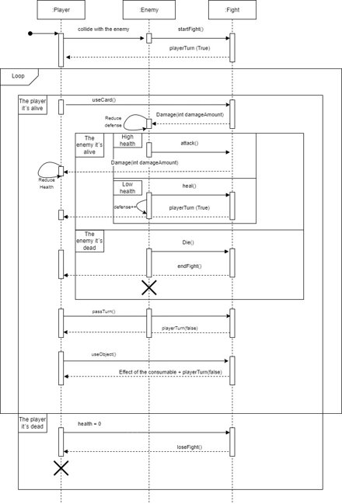
User stories and class diagram
Definition of the project’s objective and limitations
Sequence diagram
Multiple changes throughout the first two deliveries
Many different possible implementations
Limitations and new ideas
Modifications to the class diagram
Learn about Unity (class diagram)

Slide 3
Beginning of the implementation
Assets design
Learning about different techniques and tools within Unity
Coherent movement and 2D character design
Only one character could move
Design and implementation of different visual elements

Slide 4
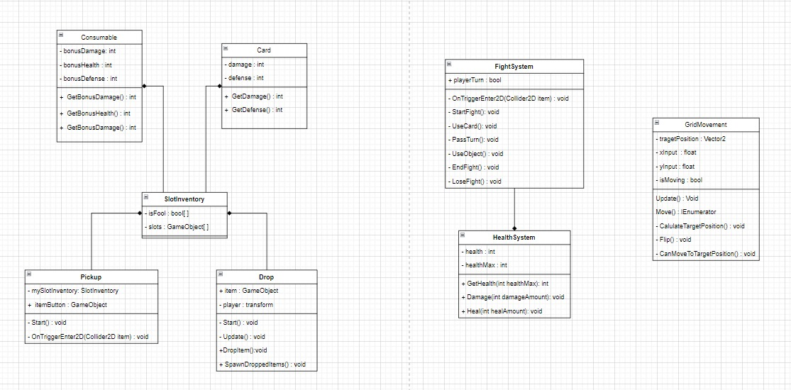

Slide 5
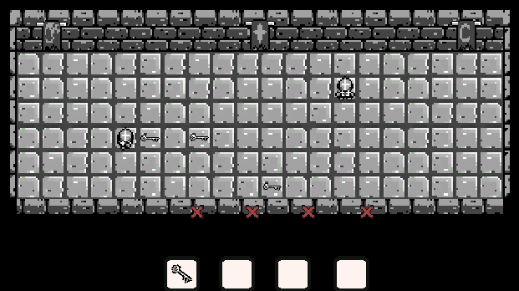
Further development and finished product
Creation and programming of a second character (enemy)
The player can now fight the enemy when nearby
Cards battle

Slide 6
